Slide 1

Azure functions
Rajesh Kolla
Full-stack developer ,Azure Architect
Email: razesh.kolla@gmail.com
Twitter: @RajeshKolla18
LinkedIn: https://be.linkedin.com/in/razeshkolla

Slide 2
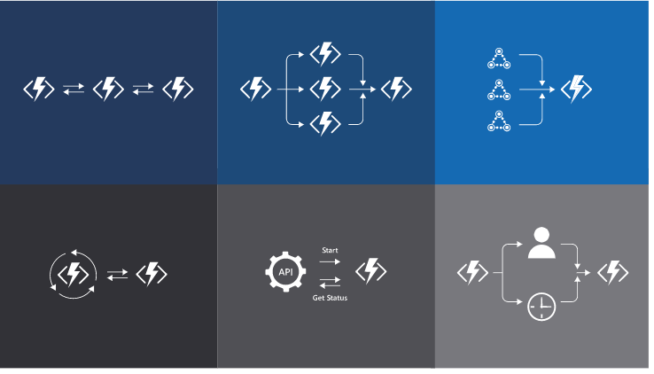
Agenda
Overview
Durable functions
Best Practices
Common Scenarios
Demos
Pricing
Wrap up
Q&A

Slide 3
Microsoft Azure serverless compute
It’s now becoming easier than ever to create small, targeted microservice architecture using a variety of services
Azure provides many services that can help you achieve a low-friction, high-throughput and low-cost solution
Azure Functions is the newest service in the serverless architecture family
Per-second Billing model
only pay when your code runs ‘
Automatic scale
Simpler
Cheaper
More scalable

Slide 4
Azure function
Azure Function is small pieces of code without worrying about underlying infrastructure .
It is triggered by a specific type of event or running on schedule or as the result of an Http request

Slide 5
Triggers & Binding
Function must have exactly one trigger
Triggers have associated data which is often provided as the payload of the function.
Service | Trigger | Input | Output
Blob Storage | ☑ | ☑ | ☑
Azure Cosmos DB | ☑ | ☑ | ☑
Event Grid | ☑ |  | ☑
Event Hubs | ☑ |  | ☑
IOT Hub | ☑ |  | ☑
Http | ☑
Queue Storage | ☑ |  | ☑
Send Grid |  |  | ☑
Service Bus | ☑ |  | ☑
Signal R | ☑ | ☑ | ☑
Table Storage | ☑ |  | ☑
Timer | ☑
Twilio |  |  | ☑
A trigger is action (or) event (or) time-based schedule which defines how function is invoked.
Binding to the function is a way of connecting another resource to function in input \output \both.
Triggers and Bindings let developer avoid hardcoding access to other services

Slide 6
Hosting Models
Per-sec billing
1m executions
400,000 GB-s
Reserved servers
Predictable monthly costs
Pre-warmed instances
VNet integration
Longer run duration
Consumption Plan
(Server less)
App Service Plan
Premium Plan
Run Anywhere
On premises
Other cloud providers
Docker Container

Slide 7
Development Environments
https://portal.azure.com
Experiments
Proof of concepts
Powerful IDE
Azure function extension
Debug and test locally
Azure portal
Visual Studio
Supported Languages
Azure functions can be created in C# , Node/JavaScript, Python, F# ,PHP and scripting languages like PowerShell ,Batch and Bash.
Cross Platform
Visual Studio code
Azure function extension
Azure Function Core Tools
https://www.npmjs.com/package/azure-functions-core-tools

Slide 8
Additional features
API Keys
Identity Provider integration such as AAD , third party identity providers
Define workflows
Orchestration of functions
Run tasks in parallel
Retries and error handling
Security
Durable Functions
Concept of Function App
Unit of Deployment
Share common configuration
Scale together
Logically related
Route incoming requests
Visual Studio code
Transform Request and Response
Proxies

Slide 9
Best Practices Performance &Storage Consideration
Avoid long running functions
Cross function communication
Write functions to be stateless
Write defensive functions
Avoid sharing storage accounts
Don't mix test and production code in the same function app
Use async code but avoid blocking calls\bottle necks
use multiple worker processes
Configure host behaviors to better handle concurrency

Slide 10
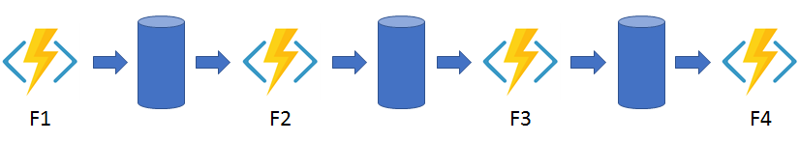
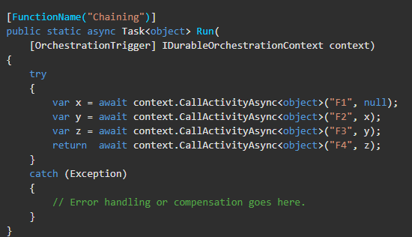
Durable Function
The main purpose of durable functions is simplifying complex, stateful requirement in serverless applications.
Pattern #1: Function chaining:- a sequence of function executes in specific order.
The output of one function is input of another function.
Durable function is an extension of Azure function. Allow developer write stateful function.
Define Stateful workflows by writing orchestrator functions and stateful entities

Slide 11
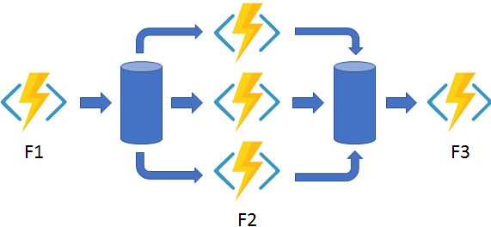
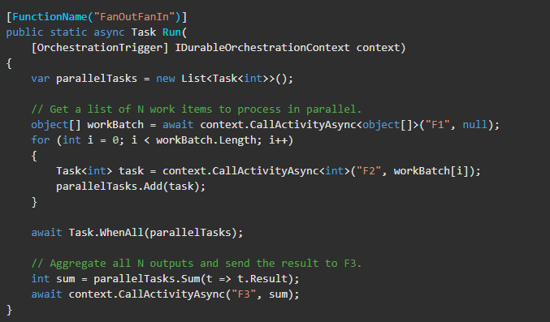
Durable Function
Pattern #2: Fan out/fan in
In this pattern, multiple functions execute in parallel and then wait for all functions to finish and then aggregate the result.
Durable function is an extension of Azure function. Allow developer write stateful function.
Define Stateful workflows by writing orchestrator functions and stateful entities

Slide 12
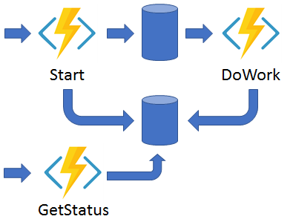
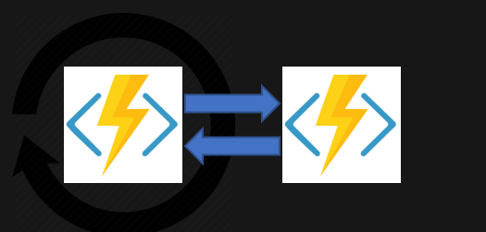
Durable Function
Pattern #3: Async HTTP APIs
The async HTTP API pattern addresses the problem of coordinating the state of long-running operations with external
Pattern #4: Monitor
recurring process in a workflow. An example is polling until specific conditions are met.
Durable function is an extension of Azure function. Allow developer write stateful function.
Define Stateful workflows by writing orchestrator functions and stateful entities

Slide 13
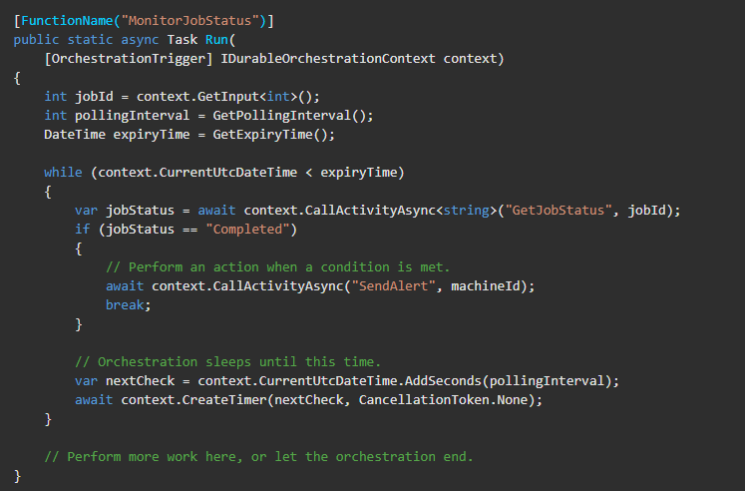
Durable Function
Durable function is an extension of Azure function. Allow developer write stateful function.
Define Stateful workflows by writing orchestrator functions and stateful entities

Slide 14
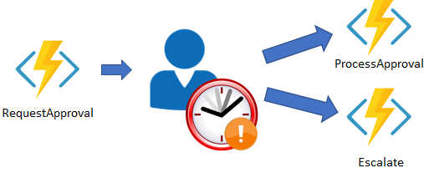
Durable Function
Pattern #5: Human interaction
this pattern is mainly used in automated process involve human interaction
Durable function is an extension of Azure function. Allow developer write stateful function.
Define Stateful workflows by writing orchestrator functions and stateful entities

Slide 15
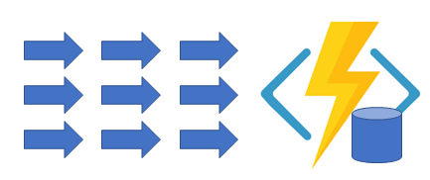
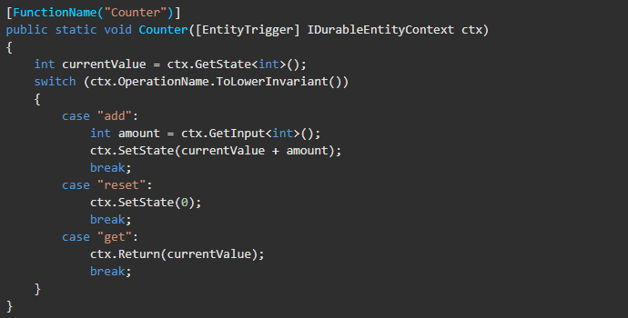
Durable Function
Pattern #6: Aggregator (stateful entities)
this is used for aggregating event data over a period of time into single entity
Durable function is an extension of Azure function. Allow developer write stateful function.
Define Stateful workflows by writing orchestrator functions and stateful entities

Slide 16






Demos
Create Function in Portal
Create Function in Visual studio
Create Function in Visual code
Running Functions in Containers
Working with Triggers and Binding

Slide 17
Q&A
Email: razesh.kolla@gmail.com
Twitter: @RajeshKolla18
LinkedIn: https://be.linkedin.com/in/razeshkolla

Slide 18
Thank you!
Email: razesh.kolla@gmail.com
Twitter: @RajeshKolla18
LinkedIn: https://be.linkedin.com/in/razeshkolla

